Slide 1
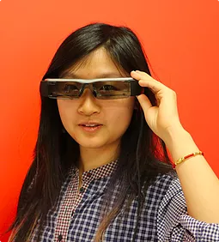

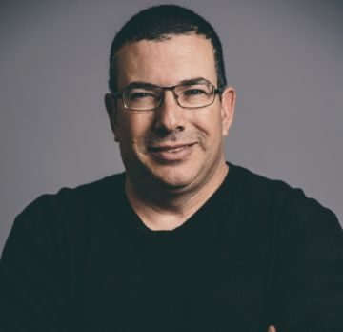
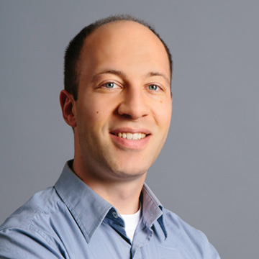


Making VR Inclusive for People with Low Vision
Meredith Ringel Morris
Microsoft Research
http://aka.ms/seeingvr
http://aka.ms/vraccess
Yuhang Zhao
(Cornell)
Andy
Wilson
Eyal Ofek
Christian
Holz
Ed Cutrell
Meredith
Ringel
Morris

Slide 2
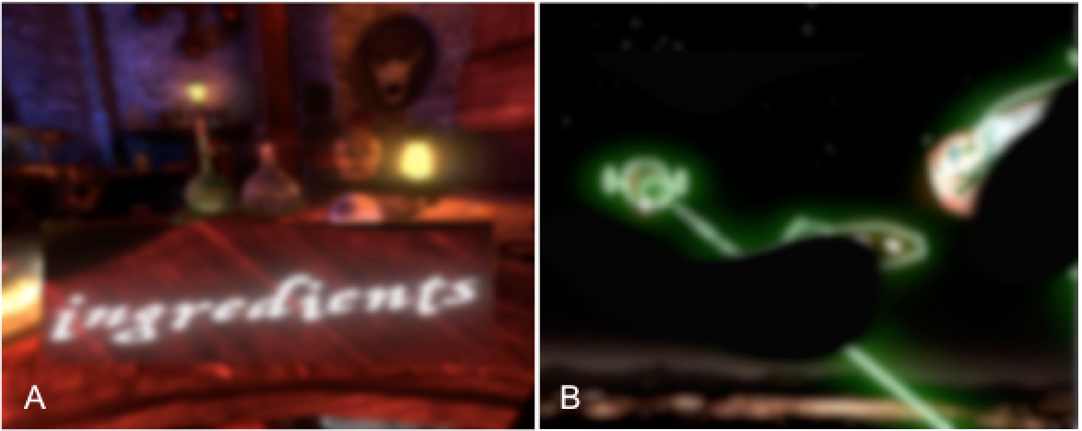
Low Vision
VR apps under simulated low vision augmented by SeeingVR: (A) Waltz of the Wizard [Aldin Dynamics, 2016] under diffuse depression of vision, with Bifocal Lens; (B) Space Pirate Trainer [I-Illusions, 2017] under blurred vision with blind spots, with Edge Enhancement and Depth Measurement.
Notes:
Low vision is a visual impairment that cannot be corrected with eyeglasses or contact lenses. This includes a variety of visual conditions such as blurred vision, loss of peripheral vision, and extreme light sensitivity. Low vision affects 217 million people worldwide. If we think of our framework of temporary or situational impairments, then this number greatly expands if we think of people who aren’t wearing their glasses, people who recently had eye surgery or eye drops, people who take medications that impact their vision, etc. Our goal is to make VR more accessible to this user group.

Slide 3
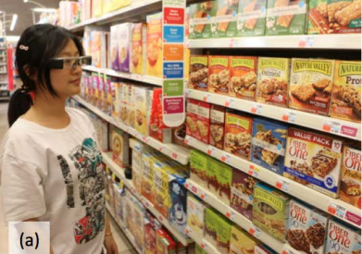
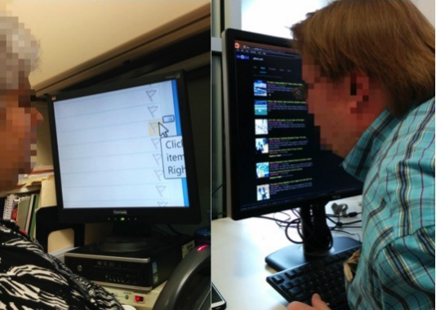
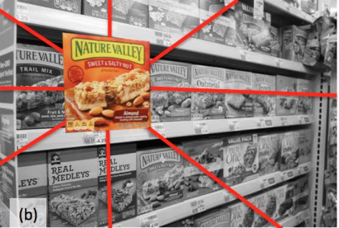
Related Work
Azenkot et al., 2016
Zhao et al., CueSee, 2016
Notes:
The GearVR Framework also supports some accessibility features, such as basic zooming and inverted color options for low vision users. Teofilo et al. evaluated these features, confirming that users with disabilities showed enthusiasm for them. These prior projects adapted basic low vision features on 2D displays to the virtual space; SeeingVR builds on prior work by considering the 3D space presented by VR, a variety of VR tasks, and a range of low vision conditions.
Related work: low-tech and status quo tools for LV, and AR for LV

Slide 4
User-Centered Design Process
Interviews and observations with six low-vision participants
Key challenges:
Seeing things at a distance: “If I’m really playing, I have to be balancing, ‘can I read from here or do I want to teleport and read it’” –L2
Interacting with virtual elements: selecting distant objects, judging depth, tracking moving targets
Dealing with lighting effects: contrast, brightness
Variety of visual conditions/abilities
Notes:
Need to teleport or walk to see things in the VR environment (or float to see things up high)
Where is laser pointer aimed? Hard to pick up virtual objects by judging distance. Tracking moving targets hard w/ reduced visual field
Contrast, brightness

Slide 5
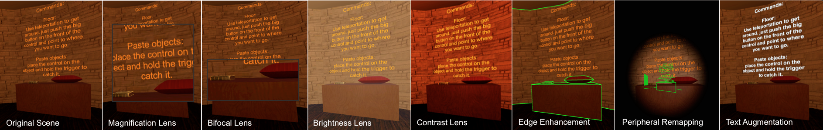
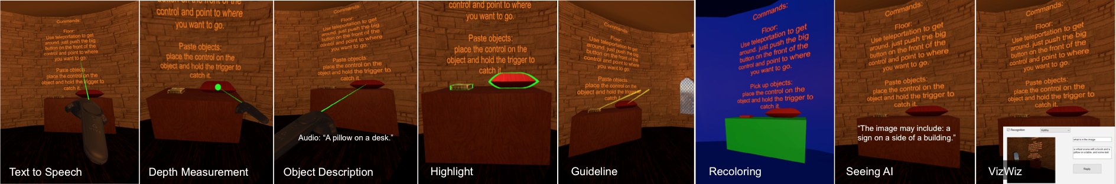
SeeingVR
14 low vision tools (9 can be applied post-hoc to Unity apps)
scene is from open-source Unity game EscapeVR-HarryPotter
Notes:
Toolkit so that users can select tools needed based on their visual abilities and the application context.Tools inspired by familiar metaphors (low-tech tools, 2D tools, smartphone apps), but adapted for 3D virtual space. Unity is one of the most widely-used platforms for VR development.
9 can be applied post-hoc, since many designers fail to take accessibility into account.
Our SeeingVR plugin augments Unity-based VR apps during runtime. After the user specifies the path of the VR app to be augmented and runs our plugin, SeeingVR adds itself to the VR app. After starting the app, the user can now select and adjust the various tools of SeeingVR in real time. We used the Illusion Plugin Architecture (IPA) [84], which allows developers to inject code into an existing Unity app in the form of a dynamic-link library (DLL). We first implemented all our low vision tools in Unity and compiled the relevant components (e.g., prefab, shader) into an AssetBundle (i.e., an archive file containing Unity data that can be loaded at runtime). We then built an IPA-compatible DLL that loads all the tools from the AssetBundle into the current VR app. Our plugin then automatically runs the IPA, injecting the DLL into a specific VR app.

Slide 6
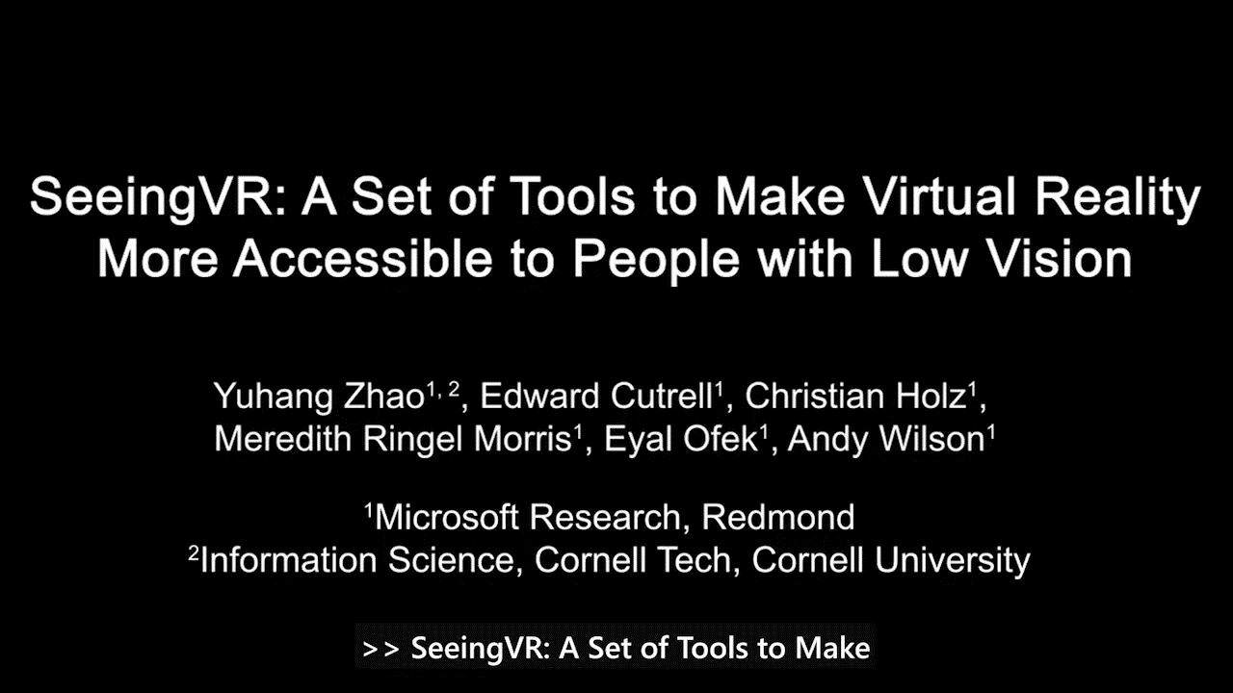
Notes:
End video around 6:20 when it starts to talk about evaluation

Slide 7
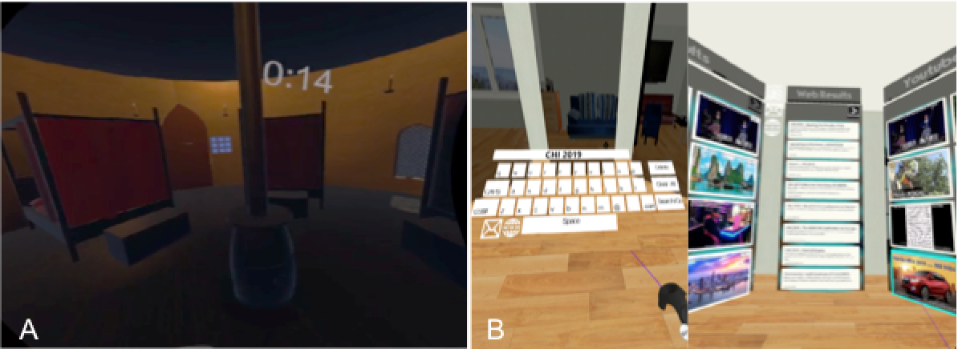
Evaluation: Users with Low Vision
Does SeeingVR enhance the usability of VR for people with Low Vision? Which tools do people find most useful? What to improve?
Participants: 11 people with low vision
Method:
Interview + Tutorial/Think-Aloud
Virtual Tasks: Menu Navigation, Visual Search, and Target Shooting
App Exploration (EscapeVR and Drop)
Notes:
Limited peripheral vision, blind spots in peripheral vision, narrow field of view, no vision in one eye, light sensitivity, etc. 8 were legally blind (acuity of less than 20/200 and/or visual field of < 20 degrees).
Controlled SeeingVR with Speech (Wizard of Oz)

Slide 8
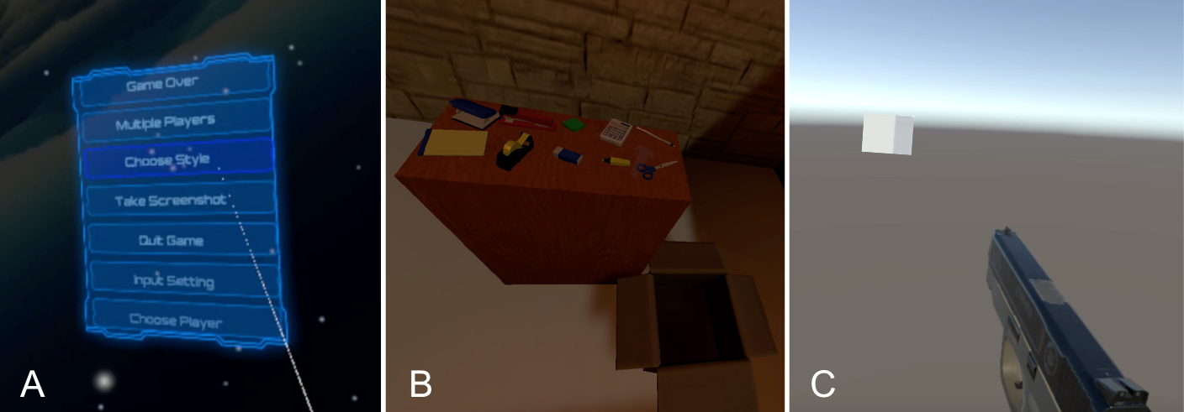
Virtual Tasks
Menu Navigation
Visual Search
Target Shooting
Notes:
People would first practice the task and decide what tools they wanted to use, before starting the measured tasks.
Our menu navigation scene had a semi-transparent blue menu with seven menu items against a dark blue background. The menu was 10 meters away from the user and measured 4.4m x 5m. The user could point and select a menu item with the laser attached to the controller. The menu was hidden at the beginning of each trial. When a trial started, the system verbally announced a specific menu item (randomly chosen). The menu then appeared, and the participant needed to select the announced item. When the item was selected, the menu disappeared. For each trial, the system randomly picked seven of fourteen menu items to display in a random order. We recorded whether participants selected the correct item and the time required
Our visual search scene was a dark room with a desk and a box. There were 10 virtual objects on the table (e.g., a pen, a stapler, etc.). The trial started with an empty desk. When the system verbally announced a specific object (randomly selected), all 10 objects appeared at random, non-overlapping locations on the desk. The participant needed to pick up the object and throw it in the box, using the controller. When an object was thrown in the box, all the objects disappeared again. We recorded selection accuracy and timing.
Our target shooting scene had 12 white cube-shaped targets evenly distributed at eye-level around a circle with a 12-meter radius. The user stood in the center of the circle and could use the controller to shoot the targets. All 12 targets were hidden at the beginning of a trial; a random target would appear and gradually moved towards the participant. When shot, the target disappeared and another randomly appeared. Participants needed to shoot five targets in each trial. We recorded time and accuracy.

Slide 9
Findings from Evaluation with PLV
All participants completed all three tasks more quickly & accurately with Seeing VR
Menu Navigation: all 11 participants successful with SeeingVR, only 4 without, all 100% accurate with SeeingVR and faster (p < .04)
Visual Search: significantly faster with SeeingVR (p < .001), 100% accuracy with SeeingVR
Target Shooting: significantly faster with SeeingVR (p < .001)
Tool preferences varied by visual condition and task
Text Augmentation, Depth Measurement, and Highlight were top-rated
Recoloring’s aesthetic change considered too large
Notes:
Tension of accessibility vs. aesthetics.
“I stopped playing FIFA because it became more realistic… they changed the visuals suddenly… I was not able to play that game after enjoying it for 10 years… At least [SeeingVR] gives me the option to be able to see. It may not be comparable or directly equal to what you may experience if you don’t have a visual impairment, but it’s an equitable experience, so that I’m still able to… participate in that game.”

Slide 10
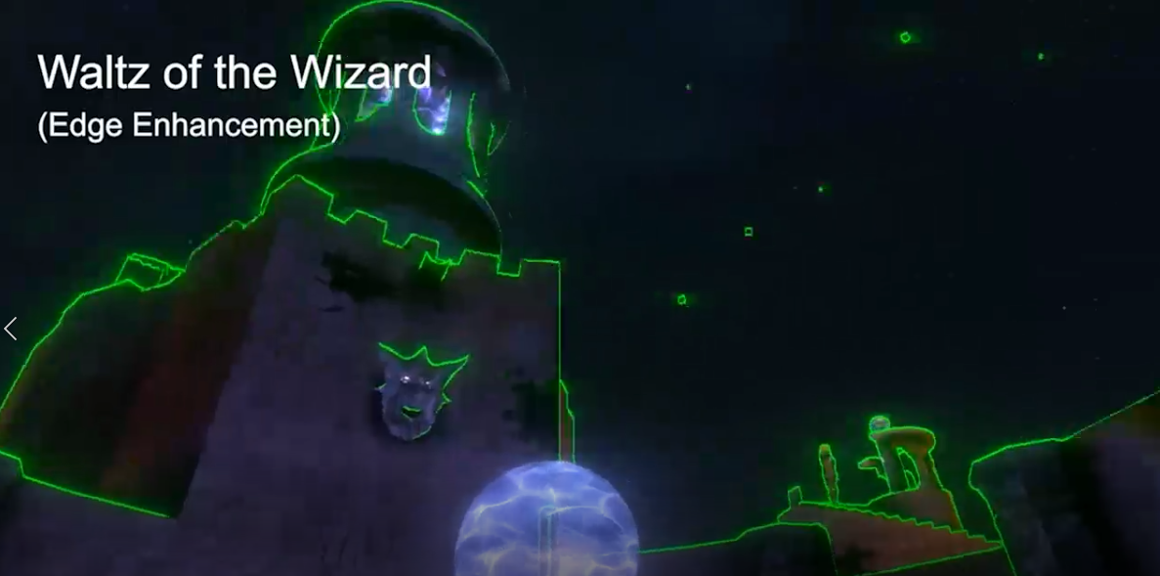
Evaluation: Generality
Can SeeingVR’s post-hoc tools successfully modify a range of VR apps?
Method: applied SeeingVR to top 10 Unity apps as ranked by Steam Spy
Notes:
Illusion Plugin artchetecture
Of the top 13 apps, 10 were Unity apps – unity is popular

Slide 11
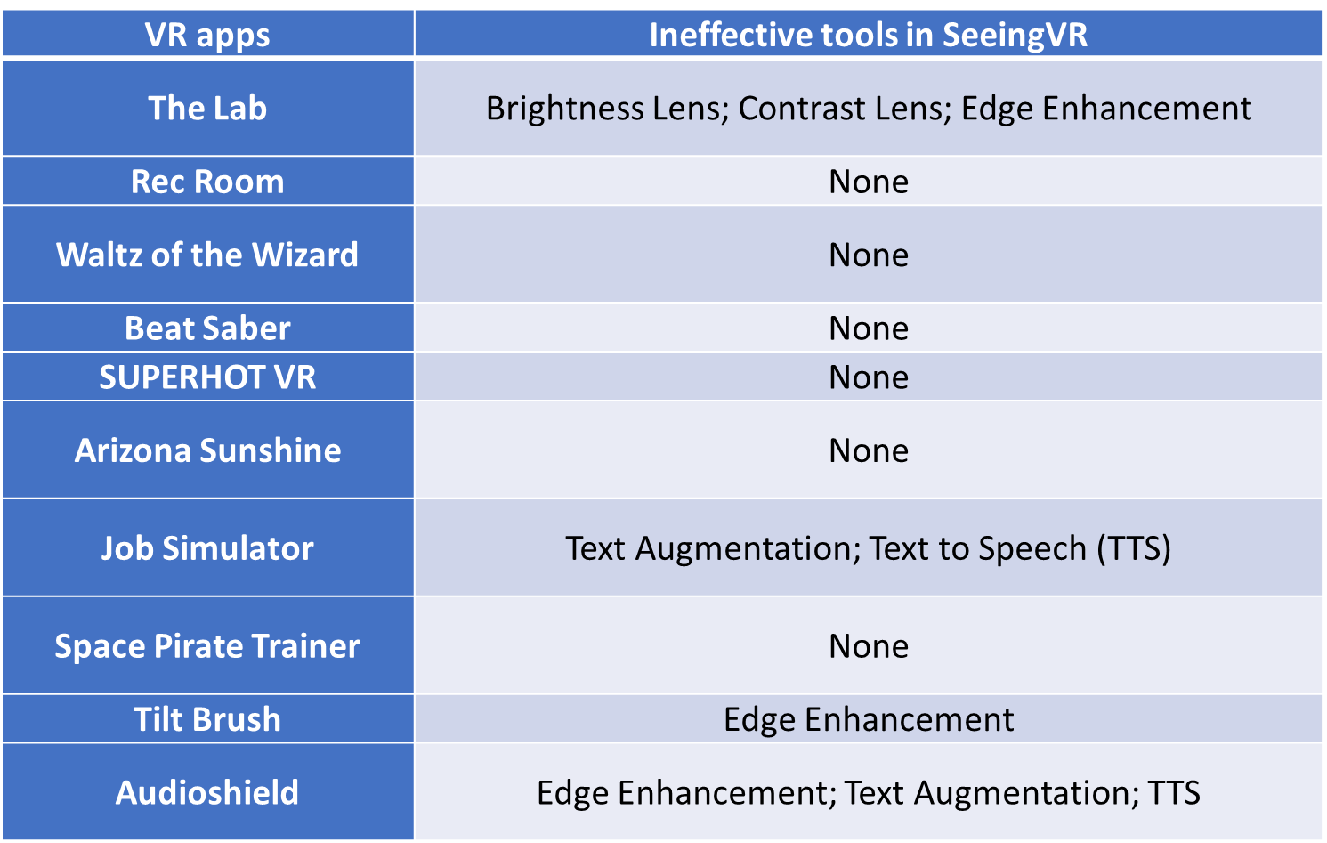
Notes:
For 60% of the apps, all of the nine low vision tools were effective
We investigated what caused the failure of some tools and found two main reasons: (1) The tool implementation conflicted with the original app implementation: the tools implemented by post-processing shaders (e.g., Edge Enhancement) conflicted with the special rendering method [87] in The Lab and the original post-processing shaders in Tilt Brush and Audioshield. (2) The app does not have any text component (Job Simulator) or the text component was obsolete (Audioshield), so that Text Augmentation and Text to Speech were ineffective

Slide 12
Evaluation: Unity Developers
How do developers feel about our 3 accessibility features? Is the toolkit easy to understand and use?
Participants: 6 Unity developers
Key Findings:
Lack of Accessibility Guidelines for VR – “Sometimes people just assume accessibility in VR is the same as accessibility on a 2D screen, which is not really right.” –D1
Toolkit Features Easy and Understandable
Preferred Toolkit to Post Hoc Modification – “…you still want them [PWD] to enjoy the original game, which is handcrafted for the best experience.” –D1
Notes:
Method: got a tutorial, and an API document we prepared. Had to apply the toolkit either to their own project or the open source Escape VR game, then did an interview
None were aware of accessibility guidelines for VR
D2 indicated filling in “description” might be too time consuming
Wanted control over the aesthetics

Slide 13
Making VR Inclusive for People with Low Vision
Meredith Ringel Morris
Microsoft Research
http://aka.ms/seeingvr
http://aka.ms/vraccess
Yuhang Zhao
(Cornell)
Andy
Wilson
Eyal Ofek
Christian
Holz
Ed Cutrell
Meredith
Ringel
Morris

